Slide 1
Sentencing Update
Alan Dorhoffer

Slide 2






Commission Resources
www.ussc.gov
 | helpline (202) 502-4545
@theusscgov
 | pubaffairs@ussc.gov

Slide 3

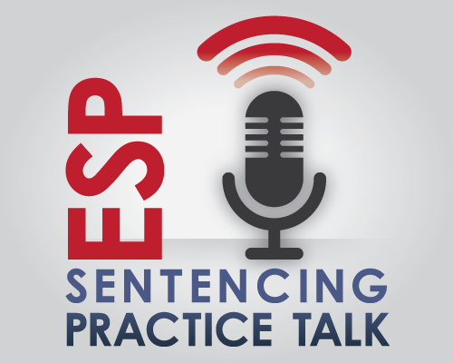
New Training Resources
Case Law Concierge
Notes:
3
3

Slide 4
Recent Commission Reports
Past Predicts the Future: Criminal History and Recidivism of Federal Offenders
Criminal History and Recidivism of Federal Offenders
Youthful Offender Report
Mandatory Minimum Penalties for Federal Sex Offenses
Recidivism Among Federal Drug Trafficking Offenders

Slide 5
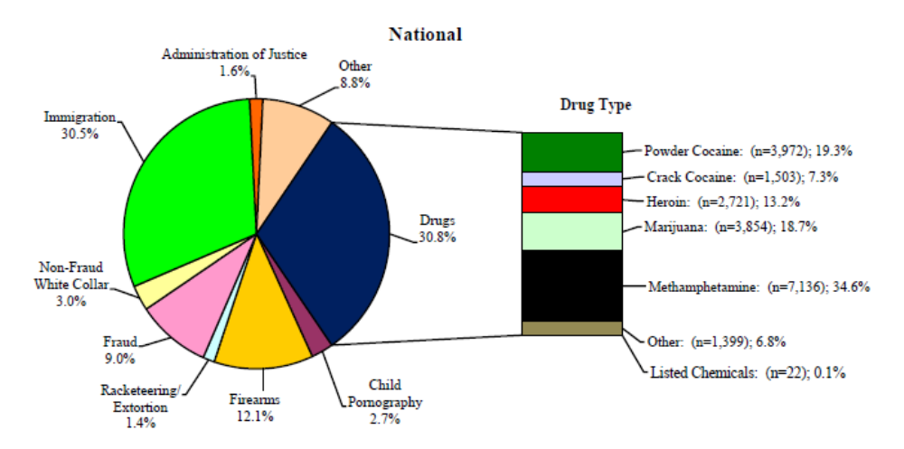
2017 National Primary Offense Types
National - FY 2016
SOURCE: 2017 Sourcebook of Federal Sentencing Statistics; 66,873 Cases Sentenced

Slide 6
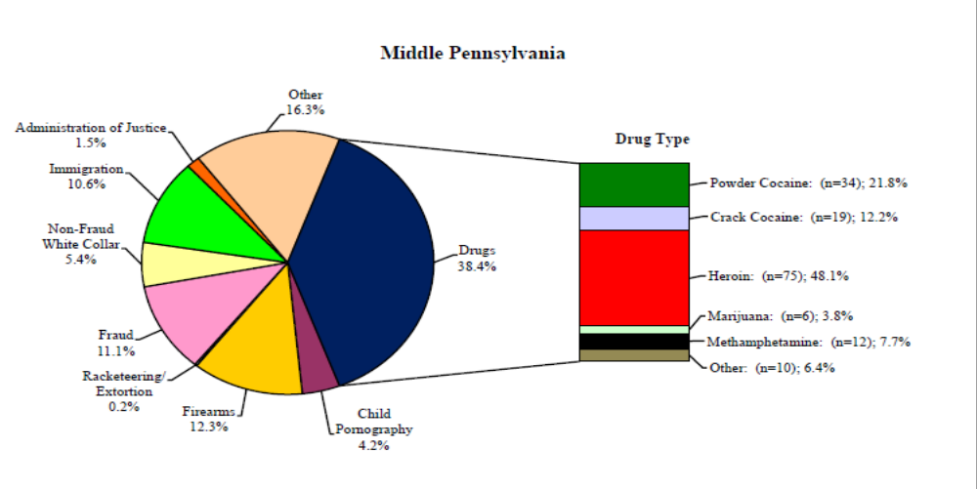
2017 Middle District of Pennslyvania
National - FY 2016
SOURCE: 2017 Sourcebook of Federal Sentencing Statistics; 406 Cases Sentenced

Slide 7
2018 Amendments

Slide 8
2018 Guideline Amendments
§2D1.1 (Drugs: Fentanyl and Synthetic Drugs)
  New increase for knowingly misrepresenting fentanyl or fentanyl analogue as another substance
  New definition of fentanyl analogue
  Establishes drug ratios and minimum offense levels for synthetic drugs (cathinones and cannabinoids)

Slide 9
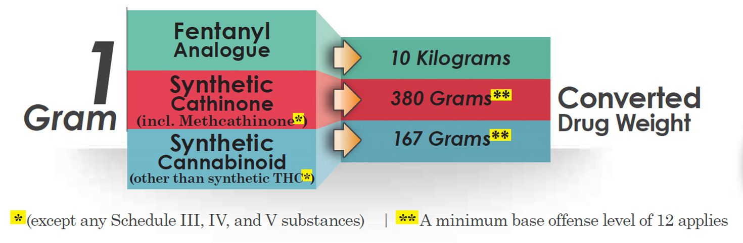

Synthetic Drugs

Slide 10
§2D1.1 Drug Trafficking, Etc.
(a) Base Offense Level (BOL) (apply the greatest): Level
(2) defendant convicted under 21/841(b)(1)(A), (b)(1)(B), or (b)(1)(C), or 960(b)(1), (b)(2), or (b)(3), and the offense of conviction establishes death/serious injury from use of the substance 38
Note See §1B1.2 for “offense of conviction”
Notes:
10
10

Slide 11
2018 Guideline Amendments
Alternatives to Incarceration for Nonviolent First Offenders
  New Application Note at §5C1.1 for court to consider alternative sentences for “nonviolent first offenders” in Zones A or B
  Eligible offenders must have no prior convictions and instant offense must not involve violence or possess a weapon

Slide 12
2018 Guideline Amendments
Acceptance of Responsibility language
  “The fact that a defendant’s challenge is unsuccessful does not necessarily establish that it was either a false denial or frivolous”

Slide 13
2018 Guideline Amendments
Marijuana Equivalency” term changed to “Converted Drug Weight”
Bipartisan Budget Act:
  Increase penalties for Social Security fraud offenses

Slide 14
Supreme Court Cases

Slide 15
Stokeling v. United States, 139 S. Ct. 544 (2019)
A robbery offense that has an element of force sufficient to overcome a victim’s resistance meets the level of force necessary to qualify as a violent felony under the elements clause of the Armed Career Criminal Act

Slide 16
U.S. v. Stitt, 139 S. Ct. 399 (2018)
Generic burglary, as described in the ACCA, includes burglary of a structure or vehicle that has been adapted or is customarily used for overnight habitation. These include mobile homes, recreational vehicles, trailers, and camping tents.
Note: check out PA burglary at § 3501

Slide 17
U.S. v. Quarles, 850 F.3d 836 (6th Cir. 2017), cert. granted, -S. Ct.-, 2019 WL 166873 (2019)
Whether Taylor v. United States’ definition of generic burglary requires proof that intent to commit a crime was present at the time of unlawful entry or first unlawful remaining, as two circuits hold; or whether it is enough that the defendant formed the intent to commit a crime at any time while “remaining in” the building or structure, as the court below and three other circuits hold.

Slide 18
U.S. v. Davis, 903 F.3d 483 (5th Cir. 2018), cert. granted, -S. Ct.-, 2019 WL 98544 (2019)
Whether the subsection-specific definition of “crime of violence” in 18 U.S.C. § 924(c)(3)(B) [residual clause], which applies only in the limited context of a federal criminal prosecution for possessing, using or carrying a firearm in connection with acts comprising such a crime, is unconstitutionally vague.

Slide 19
U.S. v. Haymond, 869 F.3d 1153 (10th Cir. 2017), cert. granted, 139 S. Ct. 398 (2018)
Whether the U.S. Court of Appeals for the 10th Circuit erred in holding “unconstitutional and unenforceable” the portions of 18 U.S.C. § 3583(k) that required the district court to revoke the respondent’s 10-year term of supervised release, and to impose five years of reimprisonment, following its finding by a preponderance of the evidence that the respondent violated the conditions of his release by knowingly possessing child pornography.

Slide 20
Supervised Release Conditions Remands
Treatment or Therapy
Associations with Others
Access to Sexually Stimulating Materials
Geography Locations
Computer Restrictions
Alcohol or Drug Treatment or Restrictions
Lifestyle Restrictions

Slide 21
Supervised Release Conditions
U.S. v. Holena, 906 F.3d 288 (3d Cir. 2018)
  “Still, internet bans are ‘draconian,’ and we have said as much ‘even in cases where we have upheld them.’ United States v. Heckman, 592 F.3d 400 (3d Cir. 2010). To gauge whether an internet or computer restriction is more restrictive than necessary, we consider three factors: the restriction’s length, its coverage, and ‘the defendant’s underlying conduct.’ Id. at 405 (emphasis removed). Sometimes we also consider a fourth factor: the proportion of the supervised-release restriction to the total restriction period (including prison).”
Notes:
21

Slide 22
Tapia and Revoking Supervise Release
U.S. v. McClure-Potts, 908 F.3d 30 (3d Cir. 2018)
  Tapia holding which prevents courts from imposing or lengthening a prison term merely to promote an offender’s rehabilitation applies to revocation sentencing.
  However, here there is no indication that the court tailored its sentence length because of rehabilitation

Slide 23
Selected Third Circuit Cases

Slide 24
View on Categorical Approach
U.S. v. Mayo, 901 F.3d 218 (3d Cir. 2018)
  “We recognize that the result we reach here is wholly unsatisfying and counterintuitive.”
  “It is hard to imagine that Congress meant for the kinds of crimes typically prosecuted as aggravated assault under state law to fall outside of the definition of “violent felony” in the ACCA. But that’s the categorical approach for you. (acknowledging that “faithful application of the categorical approach at times results in outcomes that frustrate [the] policy objective” underlying a recidivist enhancement provision).”

Slide 25
Example: Career Offender Guideline
Defendant is convicted of armed bank robbery (18 U.S.C. § 2113(a)&(d))
The defendant has three prior convictions:
  PA robbery
  PA aggravated assault
  Federal Conspiracy to commit murder in aid of rackateering
Does this defendant have two prior crimes of violence to qualify as a career offender at §4B1.2

Slide 26
Guidelines Definition of Crime of Violence
§4B1.2(a)
has as an element the use, attempted use, or threatened use of physical force against the person of another, or
is murder, manslaughter, kidnapping, aggravated assault, forcible sex offense, robbery, arson, or extortion, involves use of explosives…
Force clause
Enumerated Offenses

Slide 27
Example: ACCA
Defendant is convicted of felon-in-possession (§ 922(g))
If defendant has 3 or more violent felonies or serious drug trafficking offenses, he qualifies under ACCA
Defendant has 3 prior convictions:
  PA Armed Robbery
  PA Burglary
  NJ Possession of Child Pornography

Slide 28
Supreme Court Case Involving
Force Clause of “Violent Felony”
Johnson v. U.S., 130 S. Ct. 1265 (2010)
“The term violent…connotes a substantial degree of force.”
Need force capable of causing physical pain or injury to another
More than de minimis force

Slide 29
Crime of Violence: Robbery
U.S. v. Wilson, 880 F.3d 80(3d Cir. 2018)
  “Federal unarmed bank robbery (18 U.S.C. § 2113(a)) is a crime of violence at §4B1.2 because § 2113(a) requires proof that a defendant knowingly engaged in an act that would cause an ordinary bank teller to be intimidated and turn over money that the defendant knew he had no right to have.”
  See also, U.S. v. Johnson, 899 F.3d 91 (3d Cir. 2018) (bank robbery is a crime of violence under § 924(c)

Slide 30
Robbery
U.S. v. Peppers, 899 F.3d 211 (3d Cir. 2018)
  PA robbery (§ 3701(a)(1)(v)) at the time the defendant was convicted of this offense was not a violent felony because the statute has been interpreted to include “any amount of force applied to a person while committing a theft[,]” including the mere “use of threatening words or gestures, and operates on the mind,” and because “[t]he degree of actual force is immaterial, so long as it is sufficient to separate the victim from his property,”

Slide 31
Robbery
U.S. v. McCants, 911 F.3d 127 (3d Cir. 2019)
  New Jersey second-degree robbery entailing theft by threatening another with, or purposely putting another in fear of, bodily injury is a crime of violence under §4B1.2 under both the enumerated offense clause and the force clause

Slide 32
Aggravated Assault
U.S. v. Mayo, 901 F.3d 218 (3d Cir. 2018)
  “Because Pennsylvania aggravated assault under § 2702(a)(1) criminalizes certain acts of omission, it sweeps more broadly than the ACCA’s definition of “physical force.” and is not a violent felony

Slide 33
Aggravated Assault
U.S. v. Ramos, 892 F.3d 599 (3d Cir. 2018)
  PA second degree (§ 2702) is divisible because it contains separate punishments and criminalizes different conduct and contains separate elements.
  PA second-degree aggravated assault with a deadly weapon section is a crime of violence under career offender sentencing guideline

Slide 34
Aggravated Assault
U.S. v. Abdullah, 905 F.3d 739 (3d Cir. 2018)
  NJ aggravated assault with a deadly weapon (§ 2C:12-1(b)(2)), is a crime of violence.
  “It is [still] nearly impossible to conceive of a scenario in which a person could knowingly or intentionally injure, or attempt to injure, another person with a deadly weapon without engaging in at least some affirmative, forceful conduct.” Ramos, 892 F.3d at 612.

Slide 35
Serious Drug Trafficking Offense
U.S. v. Daniels, 915 F.3d 148 (3d Cir. 2019)
  PA possession with intent to deliver cocaine is a serious drug offense under ACCA because “the statute encompasses attempts, as defined by federal law, to manufacture, distribute, or possess w/intent to manufacture/distribute controlled substance.”
U.S. v. Glass, 904 F.3d 319 (3d Cir. 2018)
  PA § 780-113(a)(30) is a controlled substance offense.
  “The parties have failed to uncover any authority, such as state judicial decisions or pattern jury instructions, suggesting Pennsylvania would prosecute a mere offer to sell under § 780-113(a)(30).

Slide 36
RICO and Controlled Substance
U.S. v. Williams, 898 F.3d 323 (3d Cir. 2018)
  RICO is divisible and here, the indictment showed that the defendant’s predicate acts were for violations under 21 U.S.C. § 841(a)(1) and he was convicted of manufacturing, selling drugs which matches the guidelines definition of controlled substance offense.

Slide 37
Inchoate/Accomplice Liability Crimes
  Conspiracy to commit murder in aid of racketeering is not a controlled substance offense under §4B1.2
    U.S. v. McCollum , 885 F.3d 300 (4th Cir. 2018)
  Attempt crimes not crimes of violence under §4B1.2
    U.S. v. Winstead, 890 F.3d 1082 (D.C. Cir. 2018)
  WA unlawful delivery of a controlled substance is not serious drug trafficking offense under the ACCA because of mens rea of knowledge for accomplice liability
    U.S. v. Franklin, 904 F.3d 793 (9th Cir. 2018)

Slide 38
Divisible
U.S. v. McCants, 911 F.3d 127 (3d Cir. 2019)
  “Because N.J. STAT. ANN. § 2C:15-1 [Robbery] lays out alternative elements upon which prosecutors can sustain a second-degree robbery conviction, we hold that the statute is divisible.
  Thus, we have no reason to overturn the District Court’s finding that the natural reading of the plea colloquy is that McCants’s two prior robbery convictions fall under N.J. STAT. ANN. § 2C:15-1(a)(2).

Slide 39
Divisible
U.S. v. Abdullah, 905 F.3d 739 (3d Cir. 2018)
  NJ 3rd degree aggravated assault (§ 2C:12-1(b)) is divisible because it proscribes three alternative degrees of conduct, each subject to different maximum sentences

Slide 40
Remand for Mitigating Information
U.S. v. Chapman, 915 F.3d 139 (3d Cir. 2019)
  Court should have continued the sentencing when the defendant stated at the sentencing hearing that his attorney had not told him the date of the sentencing hearing, and that he would have sent the court letters from himself and family members.

Slide 41
§3B1.1 Aggravating Role
U.S. v. Van Huynh, 884 F.3d 160 (3d Cir. 2018)
  Three part-test to determine “otherwise extensive”:
  1) court must distinguish scheme’s participants from non-participants who were involved;
  2) the court must determine whether the defendant used each non-participant's services “with specific criminal intent;
  3) court must determine the extent to which those services were “peculiar and necessary to the criminal scheme.”

Slide 42
§3B1.3 (Abuse of Trust)
U.S. v. Douglas, 885 F.3d 124 (3d Cir. 2018)
  In determining whether the defendant occupied a position of trust, the key question is whether the defendant had the power to make decisions substantially free from supervision based on 1) a fiduciary or fiduciary-like relationship, or 2) an authoritative status that would lead his actions or judgement to be presumptively accepted.
  Here, the defendant was an airline mechanic who went through security without being checked and the enhancement should not have applied.

Slide 43
§3C1.1 Obstruction Of Justice
U.S. v. Welshans, 892 F.3d 566 (3d Cir. 2018)
  A defendant who “moved” child pornography files into a recycling bin when he found out police were on the way to his house was not obstruction under §3C1.1.
  “The files were easily restored, and none were lost. The fact that this process took ‘extra time’ and was raised at trial as evidence of guilt in no way amounts to a ‘material hindrance’ under Application Note 4(D).”

Slide 44
§3C1.1
U.S. v. Douglas, 885 F.3d 124 (3d Cir. 2018)
  District court erred in applying §3C1.1 based on the defendant’s failure to show up for the first day of trial. The defendant was admitted to the emergency room the night before trial and had a “verification of treatment” signed by a hospital doctor.

Slide 45
§2K2.1(b)(6)
U.S. v. Hester, 910 F.3d 78 (3d Cir. 2018)
  District court incorrectly applied §2K2.1(b)(6) because the government did not prove by a preponderance of the evidence that the defendant had committed New Jersey tampering.
  Also, in order for the enhancement to apply, the weapon must facilitate a subsequent felony offense of the kind contemplated by the Guidelines and our precedent

Slide 46
§2B1.1(b)(1) Loss
U.S. v. McClure-Potts, 908 F.3d 30 (3d Cir. 2018)
  The court correctly included food stamps and medical assistance benefits in the loss calculation
  Tax and assistance benefits can also be included under relevant conduct

Slide 47
Three Common Mistakes by Courts
Determining if a prior conviction is a “crime of violence”, “violent felony”, or “controlled substance offense”
Special conditions of supervised release
Determining Relevant Conduct in a Conspiracy

Slide 48
Mythbusters
All defendants in a conspiracy will have the same relevant conduct
If a defendant knows about prior conduct by co-defendants, he is held accountable
A defendant can be held accountable for all prior related conduct without limitation
Notes:
48

Slide 49
3-Part Analysis of (a)(1)(B)
Determinations required for acts of others to be relevant conduct
What was the scope of the defendant’s jointly undertaken criminal activity?
Were the acts of others “in furtherance of” the defendant’s jointly undertaken criminal activity?
Were the acts of others “reasonably foreseeable” in connection with the defendant’s jointly undertaken criminal activity?
AND
Notes:
49
49
49
49

Slide 50
Relevant Conduct
U.S. v. Metro, 882 F.3d 431(3d Cir. 2018)
  The court must make findings on the scope of a defendant’s involvement in a scheme, which is different than the scope of the overall conspiracy.
  After identifying the scope of conduct, the court should then analyze that conduct to determine whom the defendant ‘act[ed] in concert with’ and to whom he ‘provided inside information[.]’” (citations omitted

Slide 51
Determining Scope in a Conspiracy
§1B1.3, App. Note 3(B)
Scope of criminal activity jointly undertaken by a defendant is not necessarily the same as the scope of the entire conspiracy (i.e., Pinkerton doctrine is broader than “jointly undertaken criminal activity”)

Slide 52
Determining Scope in a Conspiracy
“Bright Line Rule” §1B1.3, App. Note 3(B)
Relevant conduct does not include the conduct of members of a conspiracy prior to the defendant joining the conspiracy, even if the defendant knows of that conduct.
Notes:
52
52
52
52

